Slide 1

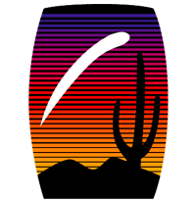

Climatic drivers of Sonoran Desert lifecycles: Saguaro and buffelgrass phenology trends using citizen science data
Julianna Renzi
Mentor: Dr. Kathy Gerst, the National Phenology Network
NASA Symposium, April 16, 2016, Tucson, Arizona

Slide 2
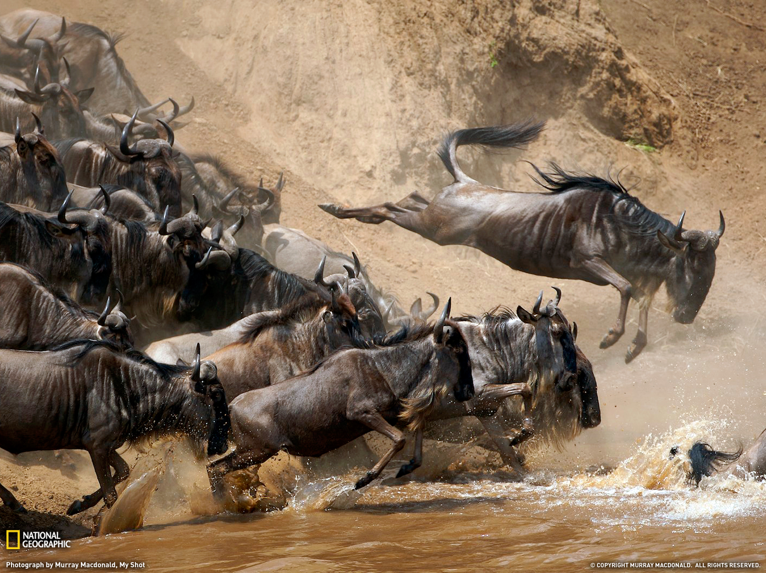
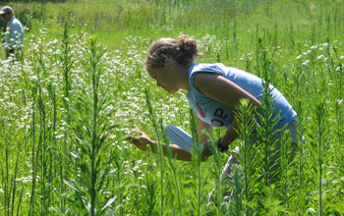
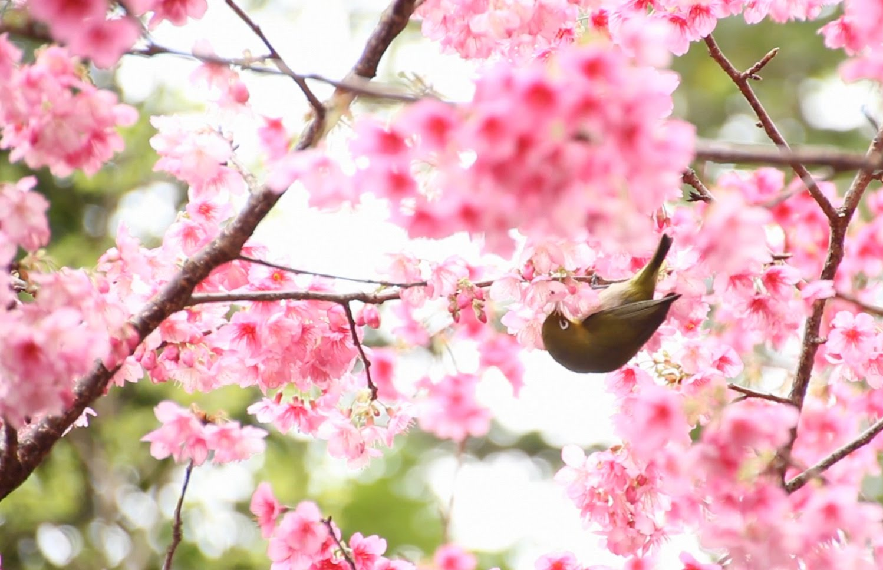
Phenology
Sources: national geographic, nsf.gov, amamiyaclinic
The lifecycles that surround us are dynamic and one of the most traceable indicators of climate change
Notes:
-When I tell people about my research people often think that they know what phenology is, but what they really think is that it’s phonology or phrenology
-Phenology is not phonology (the study of hearing) and not phrenology (the pseudoscience that studies the shape of one’s head)
-But what it actually is is something more basic than that:
-It’s the study of naturally occurring lifecycles in plants and animals
-It’s what determines when wildebeest migrate across East Africa and when the cherry blossom trees in Japan flower
-But these seasonal lifecycles are dynamic, not static—both the wildebeest migration in East Africa and the cherry blossom trees in Japan are triggered by their environmental surroundings and when those surroundings change, so does phenology
-Across the US we’ve already seen shifts in local phenologies due to warmer springs and these patterns
*In temperate areas we’ve seem warmer temps, earlier springs, and potential species mismatches as different functional groups respond differently
-This semester I worked with the National Phenology Network that is creating a nation-wide dataset of phenological observations: citizen scientists around the country can create online “Nature’s Notebook” accounts and track the phenophases occurring in their back yards
*Scientists can’t be everywhere tracking phenology all of the time: that’s the power of citizen science and part of my project was also to figure out how to can use this invaluable dataset to answer questions

Slide 3
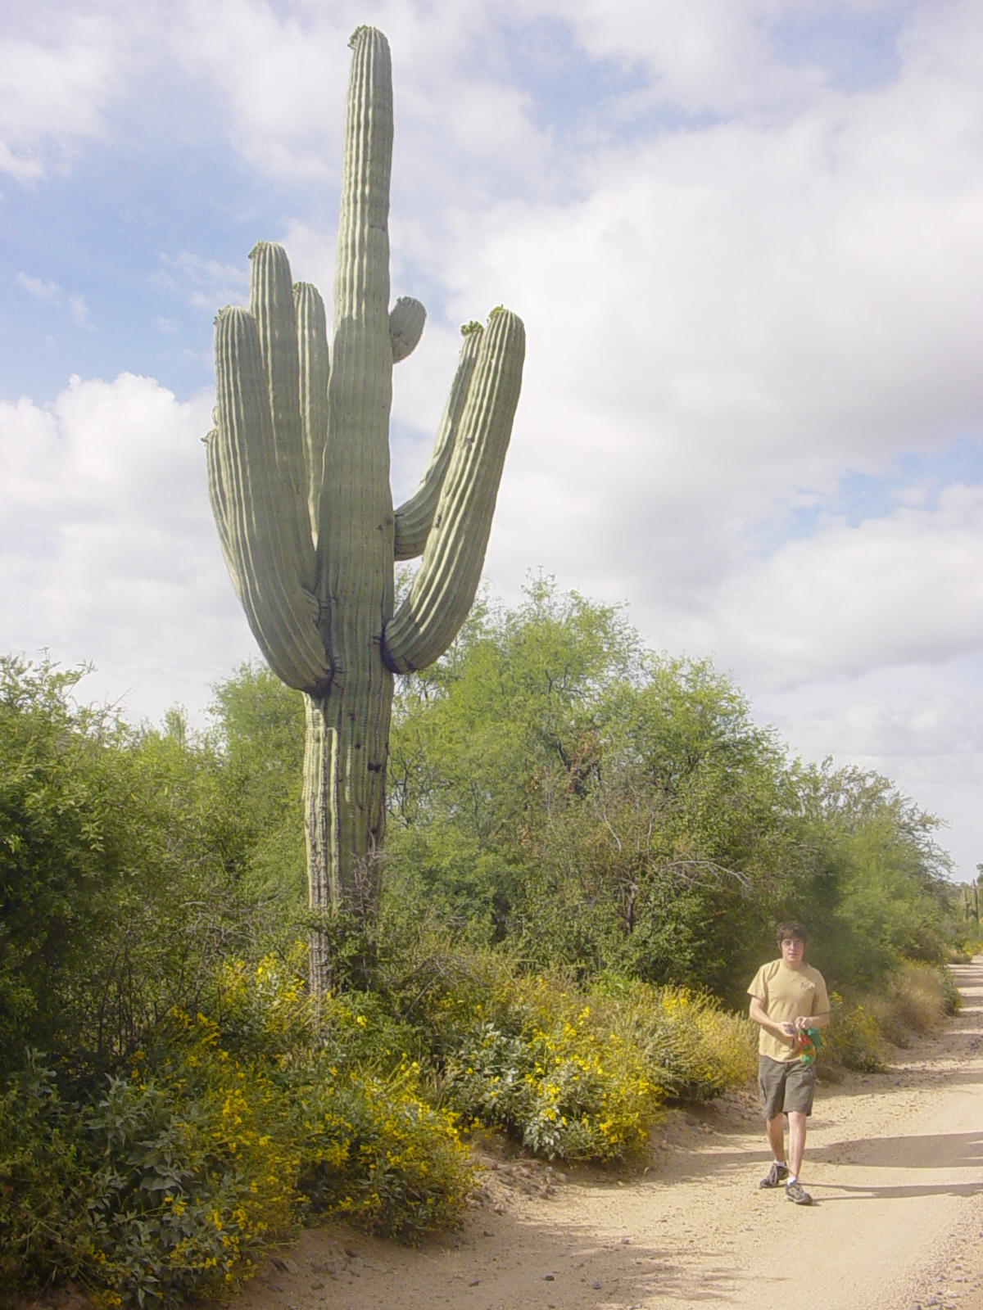
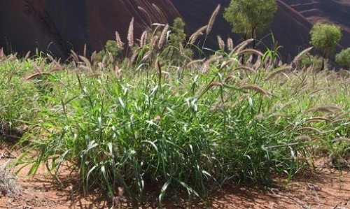
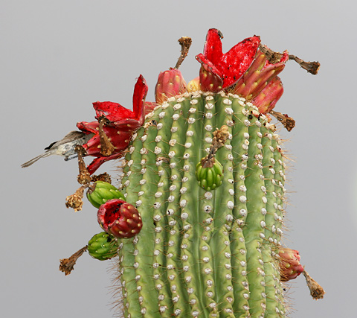
Flowering and fruiting:
Buffelgrass and Saguaro
Important species to the Sonoran Desert
Important to arid lands research
Carnegiea gigantea
Cenchrus ciliaris
Picture sources: wikipedia.org, rrisc.org, fireflyforest.net
Notes:
-I spent the first half of my internship conducting a phenology model literature review and characterizing the Arizona NN data
*Through this research I discovered that BG and saguaro have the most consistent and plentiful data
*But I also chose them because of their ecological and local significance—saguaro is an icon, the flower is our state flower, its fruits are used ritualistically by native peoples, and it is the single most ecologically connected species in the Sonoran Desert
*BG is an invasive African grass that is garnering a lot of attention because of its harmful ecosystem effects
*My OBJECTIVE was to understand what climate variables are influencing when these two organisms fruit/flower
*Understanding the phenology of these two organisms is vital for natural resource managers
-The majority of phenological research has been conducted in non-arid regions. There are long-term datasets dating back to Aldo Leopold, but most of these historic datasets are from the Northeast
-But generally arid-ecosystem phenology differs greatly from northeastern phenology and we have to start conducting more research so we can get a better grasp on how the environment around us will change with climate

Slide 4
Research Questions:
How does recent weather affect the duration of flowering and fruiting?
How do seasonal climate variables affect the onset of flowering and fruiting?
Does recent precipitation affect flowering and fruiting onset?
Notes:
-There are a million questions you can ask from the NN dataset and I spent weeks trying to figure out which questions I should ask and how I could answer those questions
-I finally settled on these three, trying to capture not just when a phenophase occurs, but also how and why it occurs
*For questions 1 and 3 I manually summed up 30-day climate statistics before the onset of an event and for question 2 I used seasonal values contained in
*I answered questions 1 and 2 with statistical software, linear regressions, and climate data from NN and Daymet’s Pixel Extraction Tool

Slide 5
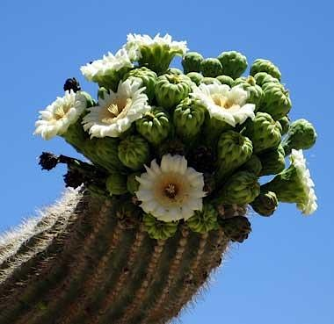
1 How does recent weather affect the duration of flowering and fruiting?
p=0.024
r²=0.163
p=0.029
r²=0.52
Buffelgrass flowering and fruiting followed the same pattern
Picture Source: www.statesymbolsusa.org
Notes:
-In Season #1 Saguaro (flower) and BG (flower and fruit) showed negative relationships
-BUT found in Season 2 temperatures increased duration in saguaros (flowers) and BG (flowers and fruits)
-Also found in Season #2 that temperatures and precipitation increased duration of Fruiting in BG
*Precipitation seems to be *very* important to BG in Season #2-monsoons?
*Only precip duration relationship

Slide 6
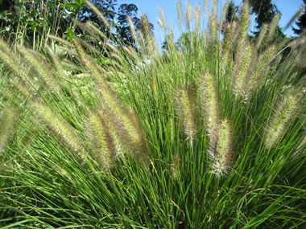
2 How do seasonal climate variables affect the onset of flowering and fruiting?
p<0.0001
r²=0.77
p=0.0007
r²=0.99
Buffelgrass fruiting followed the same pattern
Photo Credit: Matt lavin
Notes:
-Found that both flowering and fruiting was earlier with warmer temperatures in BG in both seasons using spring and winter temps
-Precipitation relationship weaker—most insignificant
-Almost no statistically significant relationships for the saguaro
*Probably a longer time scale than what I looked at

Slide 7
3 Does recent precipitation affect flowering and fruiting onset?
Notes:
To answer question 3:
-Was very clear that saguaros flowered/fruited in periods of drought
-Clear BG reacted strongly to precipitation events
-On a shorter time scale drought matters to saguaros, but on a longer time scale rain? Previous monsoon (Tierney)?

Slide 8
Significance
Changes in rainfall may affect the two species differently
Warmer seasonal temperatures may cause earlier onset in buffelgrass
Warmer temperatures may lead to shorter flowering periods during the first half of the year and longer periods in the second half of the year
Further research with a larger time scope is needed for saguaros
Notes:
Statement of the problem > objectives > methods/activities/analysis techniques > results > interpretations/significance

Slide 9
Acknowledgements
This project would not have been possible without the support of the USA National Phenology Network, NASA Space Grant, dedicated Nature’s Notebook observers, and the mentorship of Dr. Kathy Gerst.
Notes:
Most important part of the program

Slide 10
Thank You

Slide 11
References
USA National Phenology Network (USA-NPN), 20101015, Plant and Animal Phenology Data for the United States: None N/a, USA National Phenology Network, Tucson, Arizona, USA
Thornton, P.E., M.M. Thornton, B.W. Mayer, N. Wilhelmi, Y. Wei, R. Devarakonda, and R.B. Cook. 2014. Daymet: Daily Surface Weather Data on a 1-km Grid for North America, Version 2. ORNL DAAC, Oak Ridge, Tennessee, USA. Accessed on 01/2016-03/2016. Arizona.

Slide 12
Species | Phenophase | # Individuals | # Sites | Years
Saguaro | Flowering | 23 | 10 | 2010-2014
Buffelgrass | Flowering | 49 | 9 | 2009-2014
Saguaro | Fruiting | 11 | 5 | 2011-2014
Buffelgrass | Fruiting | 34 | 8 | 2011-2014
Notes:
METHODS
-I looked at flowering (FFB/FH) in both species as well as fruiting (FFB/FH) because of the ecological relevance (flowers are used by pollinators and fruits are eaten by surrounding organisms)
-We used data for flowering phenophases on twenty-three saguaros (10 sites; 2010-2014) and forty-nine buffelgrass individuals (9 sites; 2009-2014) in addition to data for fruiting phenophases on eleven saguaros (5 sites; 2011-2014) and thirty-four buffelgrass individuals (8 sites; 2011-2014) within Arizona
*Had to filter out some data based on how many days since last observation, etc.
-Also has been significant research that states that organisms respond to climate differently in different seasons (e.g. in first half of the year rainfall may be important, whereas in the second half of the year temperature is)

Slide 13
(3) Does recent precipitation affect fruiting/flowering onset?
Notes:
Can see that buffelgrass seems to respond to precipitation—this is just at one site

Slide 14
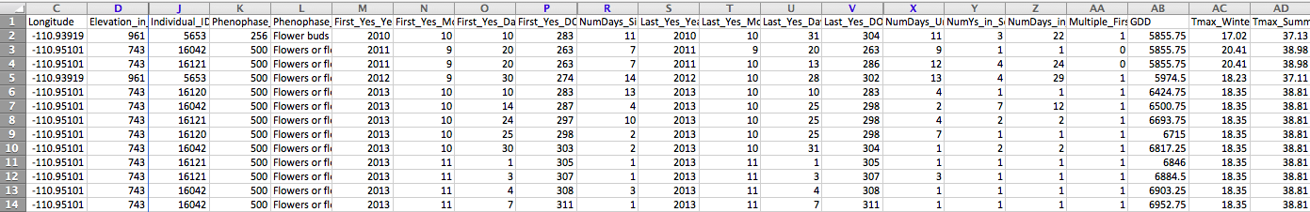
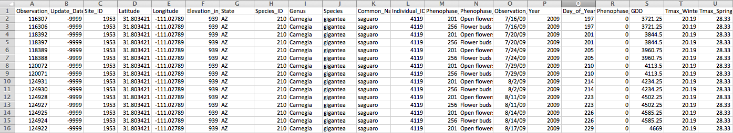
Summarized and filtered Nature’s Notebook data
Raw Nature’s Notebook data

Slide 15
Conclusions
Buffelgrass and saguaro phenology responded differently to climate
  Less precipitation before saguaro flowering/fruiting, but more before buffelgrass events
The duration of BG and Saguaro flowering decreased with increasing temperatures in Season #1, whereas in Season #2 it increased with temperatures
BG fruiting duration in Season #2 increased with precipitation and temperatures
Seasonal climatic variables had a stronger influence on the onset of phenophases for buffelgrass compared to saguaro
Warmer fall, spring and winter temperatures were related with earlier onset in buffelgrass fruiting and flowering

